Slide 1

Exception Handling
Your success is our success
Funny Gorilla 诙猩猩
Notes:
Notes for title slide

Slide 2
Why Exception Handling?

Slide 3
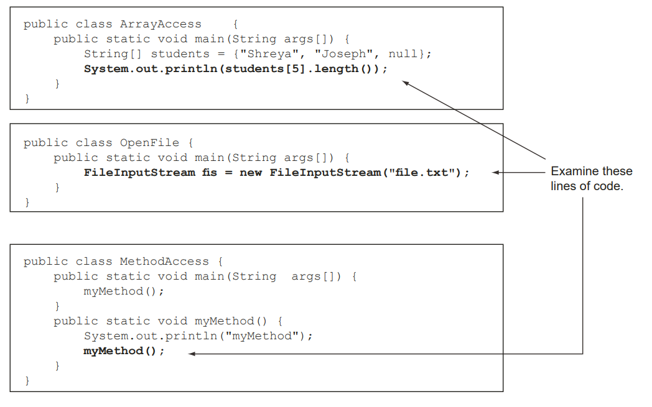

Slide 4
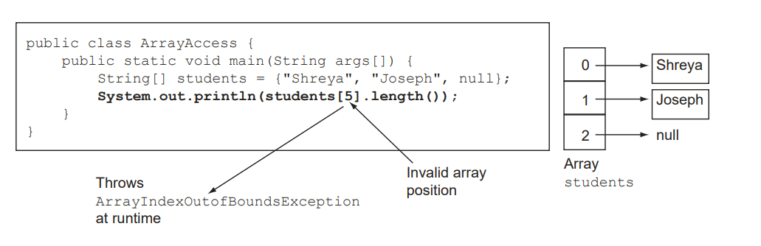

Slide 5
Java’s way to handle
Try {
// try something, that might throw exception
} catch () {
// define a handling mechanism
}final {
// define what you are going to do after all.
}

Slide 6
Handles exceptions separately from normal business logic flow

Slide 7
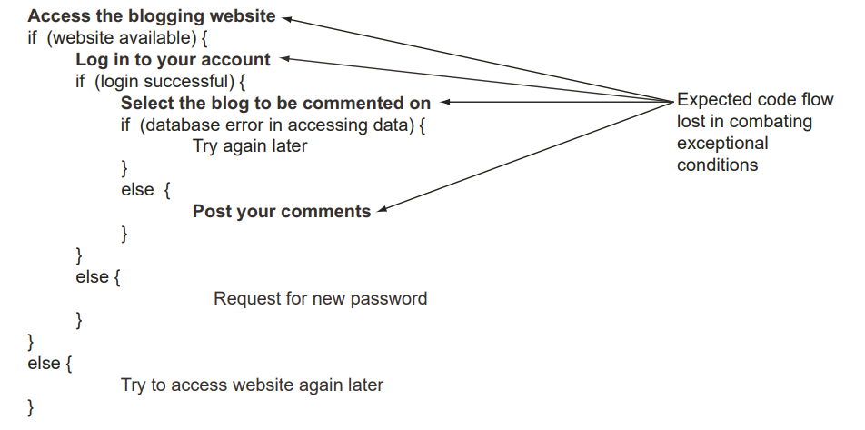

Slide 8
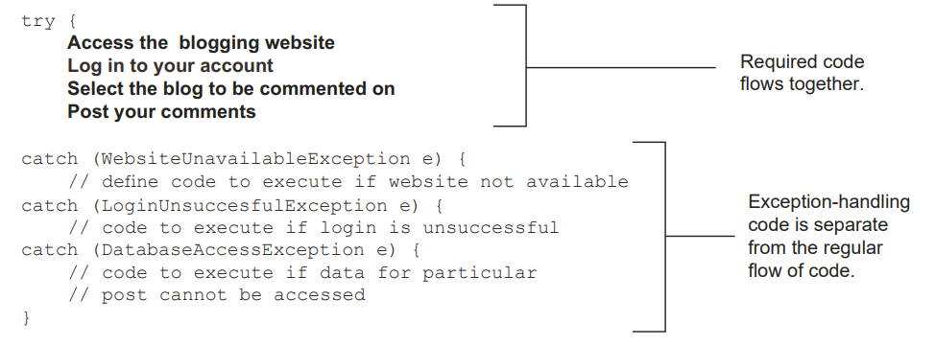

Slide 9
Stack trace

Slide 10
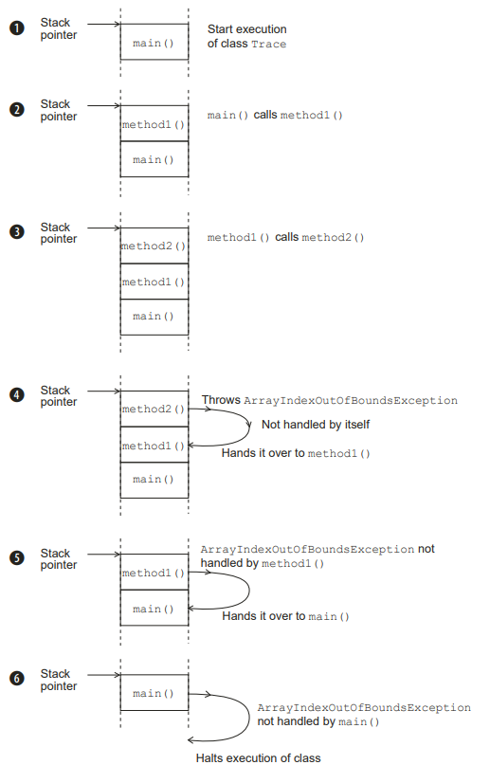
What happens when exception throws?

Slide 11
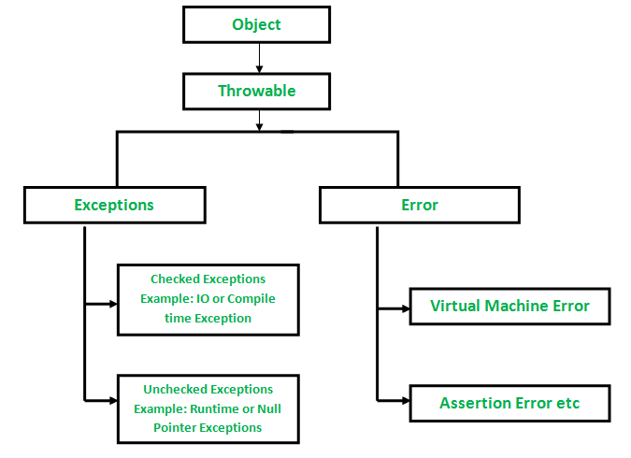
Class Hierarchy
an unacceptable condition foreseen by the author of a method but outside their immediate control.
a representation of a programming error

Slide 12
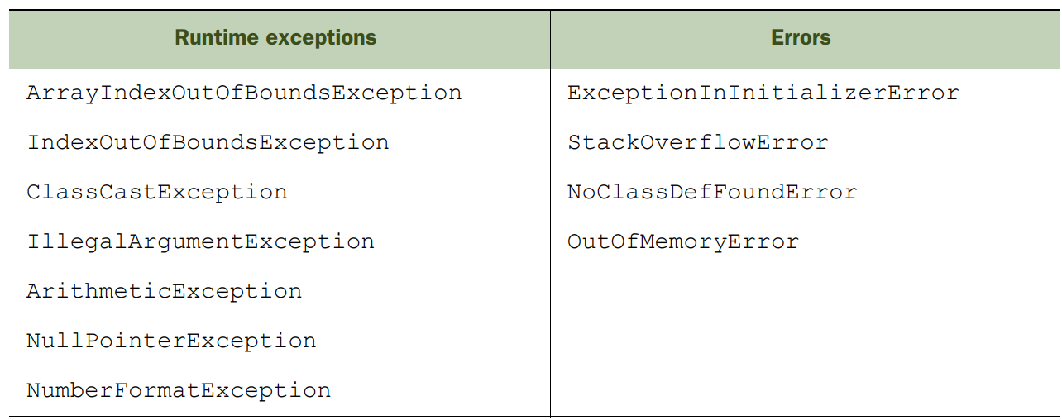
Common Exceptions

Slide 13
Handling Strategies

Slide 14
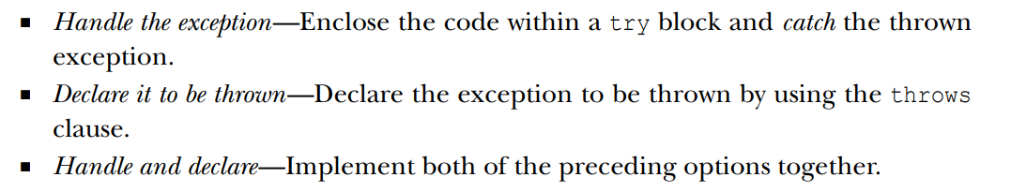

Slide 15
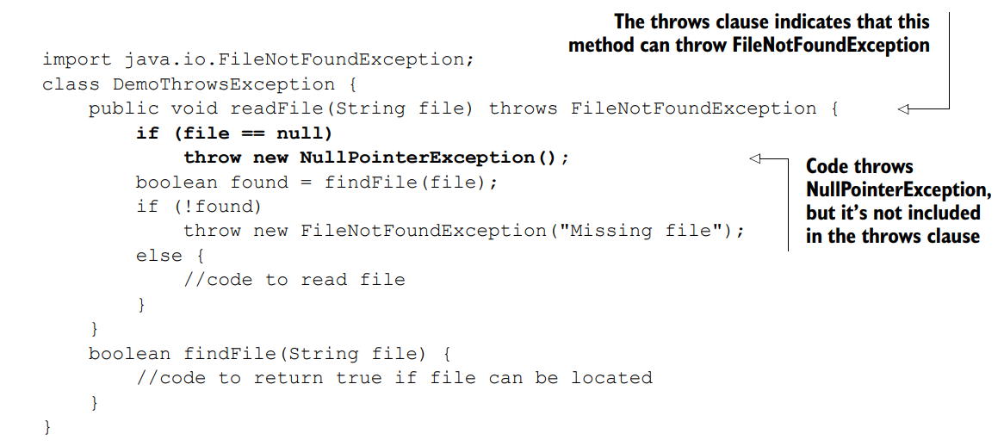
Declare to be thrown

Slide 16
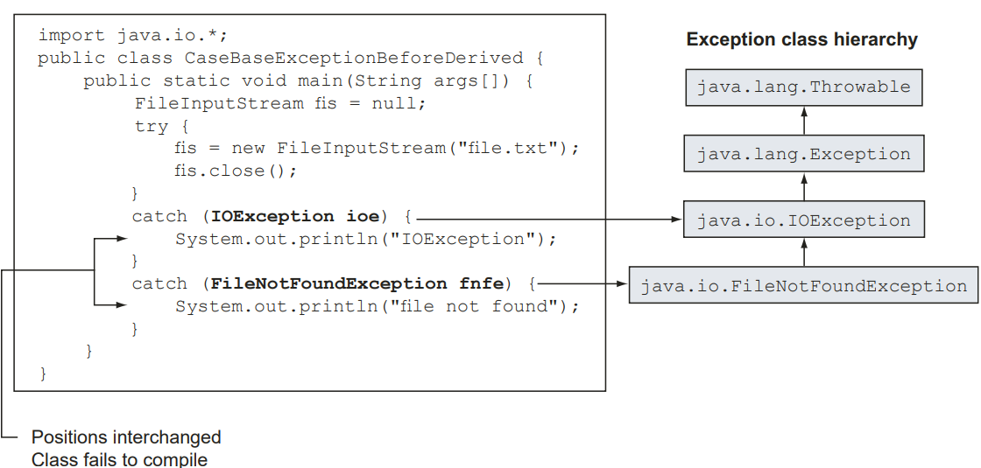
The order of placement of exception handlers

Slide 17
Reference
https://www.callicoder.com/java-arraylist/

Slide 18

Your success is our success
Contact
Mail: info@funnygorilla.com.au
Linkedin: https://mt.linkedin.com/in/songqing-gu-2ba9034b/de
Web Chat: FunnyGorilla
Phone: 0420891343

